Slide 1
STATISTICS USING PYTHON
REFINING COMPUTER SALES STRATEGY THROUGH STATISTICAL ANALYSIS PROJECT PART-1
MENTOR: MUNNA PANDEY
SUBMITTED BY:
M.PRIYANKA

Slide 2
BUSINESS OBJECTIVE1
Enhance product strategy and sales performance through
specification-Based analysis
Analyze Purchase Likelihood Based on Specifications.
The company wants to understand the likelihood of customers purchasing specific computer configurations based on a combination of desired features (RAM size, processor speed, size of the computer screen).
What is the probability of a customer purchasing a computer with at least 8GB of RAM, computer screen size of 14 inch, and a processor speed exceeding 33 MHz?
# Filtering for specified configurations
filtered_data = df[(df['ram'] >= 8) & (df['screen'] == 14) & (df['speed'] > 33)]
# Checking the count of filtered rows
n_specified = len(filtered_data)

Slide 3
print(f"Number of computers with specified configurations: {n_specified}")
OUTPUT: Number of computers with specified configurations: 1003
# Total number of computers in the dataset
n_total = len(df)
# Calculating probability
probability = n_specified / n_total
print(f"Total computers: {n_total}")
print(f"Probability of purchase with specified configurations: {probability:.2f}")
OUTPUT:Total computers: 6259
Probability of purchase with specified configurations: 0.16
INTERPRETATION: From that identified the probability of a customer purchasing a computer with at least 8GB of RAM, computer screen size of 14 inch, and a processor speed exceeding 33 MHz is 0.16

Slide 4
Probability of Selling Premium Computers
1)What is the probability of selling a premium computer?
2)Given that a computer is premium, what is the probability that it has a CD player?
1→What is the probability of selling a premium computer?
# Total computers and premium computers
n_total = len(df)
n_premium = len(df[df['premium'] == 'yes’])
# Probability
p_premium = n_premium / n_total
Print(f"Probability of selling a premium computer: {p_premium:.2f}")
OUTPUT: Probability of selling a premium computer 0.90
2→ # Filter premium computers
premium_computers = df[df['premium'] == 'yes’]

Slide 5
# Count premium computers with a CD player
n_premium_with_cd = len(premium_computers[premium_computers['cd'] == 'yes’])
# Conditional probability
p_cd_given_premium = n_premium_with_cd / n_premium
print(f"Probability of a premium computer having a CD player: {p_cd_given_premium:.2f}")
OUTPUT: Probability of a premium computer having a CD player0.50
INTERPRETATION:From this identified the probability of selling a premium computer is 0.90 and also Probability of a premium computer having a CD player is 0.50

Slide 6
BUSINESS OBJECTIVE2
Assessing Price Disparities Between Premium and Non- Premium Computers as compared to prices of both categories together
1) What is the average price of computers in the population/whole data?
avg_price = df['price'].mean()
print(f"Average price of computers in the dataset: ${avg_price:.2f}")
OUTPUT: Average price of computers in the dataset 2219.58
2) How does the average price of samples vary when data is sampled using different sampling techniques?
sample_random = df.sample(n=30, random_state=1)
avg_price_random = sample_random['price'].mean()
print(f"Simple Random Sampling Avg Price: ${avg_price_random:.2f}")
OUTPUT: Simple Random Sampling Avg Price 2466.87

Slide 7
# Split data into groups
premium = df[df['premium'] == 'yes’]
non_premium = df[df['premium'] == 'no’]
# Proportional sample sizes
sample_premium = premium.sample(n=21, random_state=1) # 70% of 30
sample_non_premium = non_premium.sample(n=9, random_state=1) # 30% of 30
# Combine and calculate averagesample_stratified = pd.concat([sample_premium, sample_non_premium])
avg_price_stratified = sample_stratified['price'].mean()
print(f"Stratified Sampling Avg Price: ${avg_price_stratified:.2f}")
OUTPUT: Stratified Sampling Avg Price 2203.93
INTERPRETATION: From this identified the average price of computers in the dataset.

Slide 8
BUSINESS OBJECTIVE3
Understanding Computer Price Trends Through Distribution Analysis
1) How does the distribution of sample means change for computer prices with different sample sizes?
import matplotlib.pyplot as plt
import numpy as np
sample_sizes = [10, 30, 50, 100] # Define sample sizes and number of repetitions
num_samples = 1000 # Number of samples to draw for each size
sample_means = {}for size in sample_sizes:
means = [df['price'].sample(n=size, replace=True).mean() for _ in range(num_samples)]
sample_means[size] = meansplt.figure(figsize=(12, 4))
for size, means in sample_means.items():
plt.hist(means, bins=30, alpha=0.5, label=f"Sample size = {size}")

Slide 9
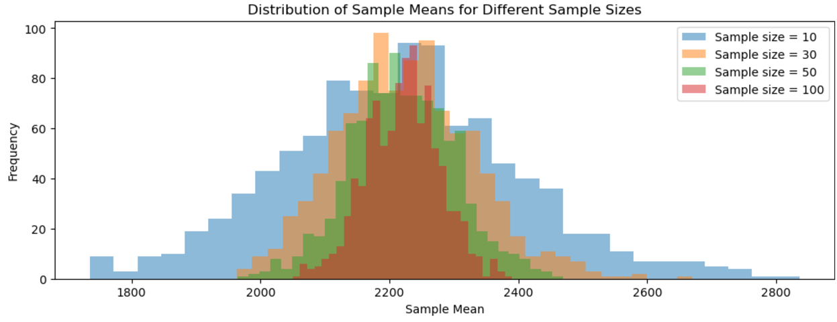
plt.title("Distribution of Sample Means for Different Sample Sizes")
plt.xlabel("Sample Mean")
plt.ylabel("Frequency")
plt.legend()plt.show() OUTPUT:

Slide 10
REFINING COMPUTER SALES STRATEGY THROUGH STATISTICAL ANALYSIS PROJECT PART-2

Slide 11
BUSINESS OBJECTIVE4
Analysing advertising Budget for premium computers by Identifying Budget
Allocation
The advertising budget spent on promoting premium computers in 2023 is increased as compared to 2022. The mean advertising budget was 221.3 billion dollars in 2022, and it was 222.2 billion dollars in 2023. A promoter in this company believes that the average advertising budget is higher than that of 2022. Priya, a data analyst, randomly selected 40 premium computers to check this notion.
Use a 5% level of significance to test Maya's hypothesis. Consider normally distributed data in the population, and the standard deviation is 74.83.
import math
from scipy.stats import norm

Slide 12
mu_2022 = 221.3
# Mean advertising budget in 2022
sample_mean_2023 = 222.2
# Sample mean advertising budget in 2023
std_dev = 74.83 # Population standard deviation
sample_size = 40 # Sample size
alpha = 0.05 # Significance level
z_stat = (sample_mean_2023 - mu_2022) / (std_dev / math.sqrt(sample_size))
# Calculate the p-value for the one-tailed test
p_val = 1 - norm.cdf(z_stat)
z_critical = norm.ppf(1 - alpha)
print(f"Z-statistic: {z_stat:.2f}")
print(f"Critical Z-value: {z_critical:.2f}")

Slide 13
print(f"P-value: {p_val:.4f}")
if (z_stat<z_critical) and (p_val>alpha):
print("Reject the null hypothesis (H0): The average advertising budget is significantly higher in 2023.")
else:
print("Fail to reject the null hypothesis (H0): Insufficient evidence to conclude that the average advertising budget is higher in 2023.")
OUTPUT:Z-statistic: 0.08
Critical Z-value: 1.64
P-value: 0.4697
Reject the null hypothesis (H0): The average advertising budget is significantly higher in 2023.
INTERPRETATION: From this identified the it rejects the null hypothesis it means the budget is higher in 2023.

Slide 14
CONCLUSION:
From the project 1the data set is more focusing on the ram and screen and speed and Cd . And total computers are 6259
And also the computers with these configurations are 1003. And also the Probability of those purchase with specified configurations is 0.16.
From business objective 2 the probability of selling premium computers are 0.90 and also the probability of selling premium computer with having the cd player is
0.50.
From project 2 identified the average budget is significantly higher in 2023 and also it rejects the null hypothesis.

Slide 15
THANK YOU

